Slide 1
Sample export from Video2Any
Source: MIT OpenCourseWare, 6.0001 Introduction to Computer Science and Programming in Python, Fall 2016 — Lecture 1, "What is Computation?" (CC BY-NC-SA 4.0).
Video2Any detected 46 slides in the lecture recording; this excerpt contains the first 12, exactly as extracted. See the full deck at https://video2any.com/decks/mit-what-is-computation
Slides are full-frame images of what appeared in the video. In the app, OCR can additionally place the recognized text as editable text boxes.

Slide 2
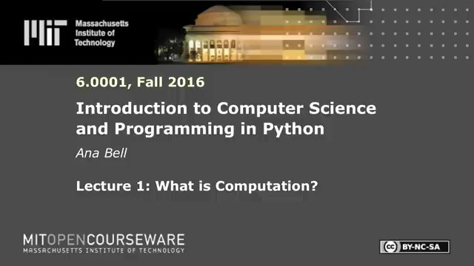

Slide 3
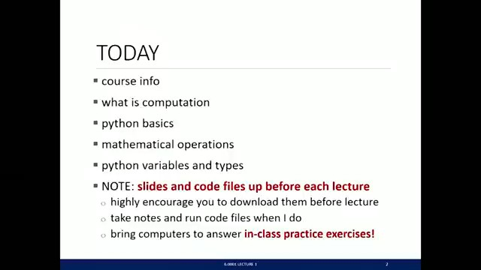

Slide 4
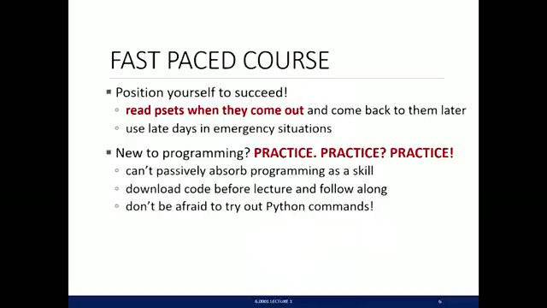

Slide 5
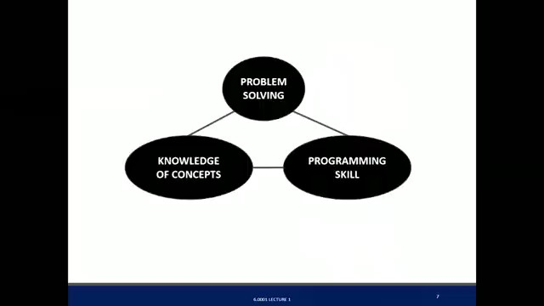

Slide 6
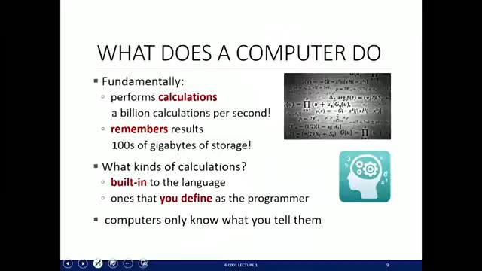

Slide 7
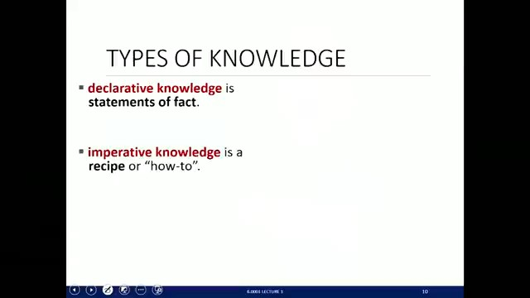

Slide 8
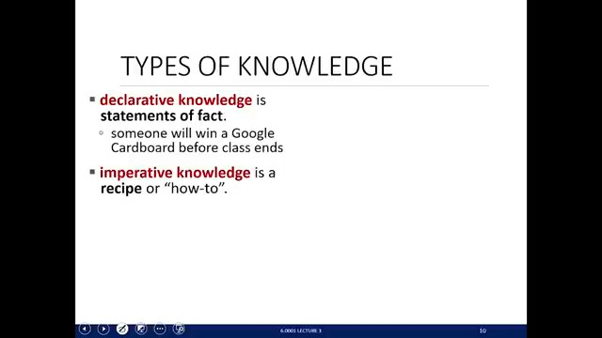

Slide 9
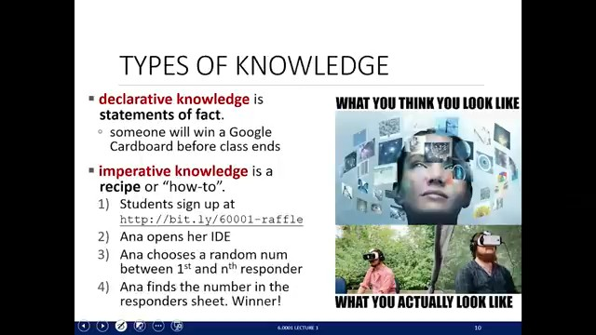

Slide 10
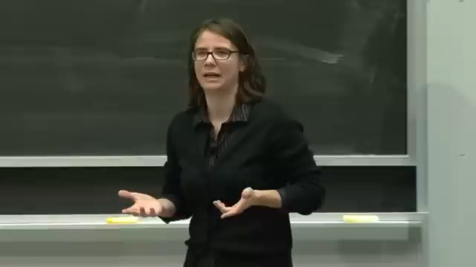

Slide 11


Slide 12
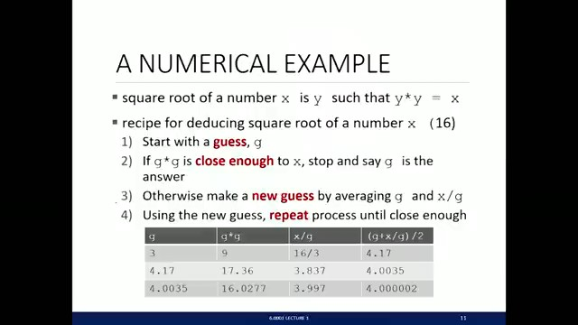

Slide 13
